Slide 1
Parallel Data Storage, Analysis, and Visualization of a Trillion Particles
Suren Byna
J. Chou, O. Rübel, Prabhat, H. Karimabadi, W. S. Daughton, V. Roytershteynz, E. W. Bethel, M. Howison, K.-J. Hsu, K.-W. Lin, A. Shoshani, A. Uselton, and K. Wu
Lawrence Berkeley National Laboratory
Tsinghua University, Taiwan
University of California - San Diego
Los Alamos National Laboratory
Brown University

Slide 2
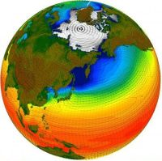
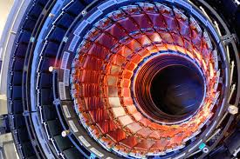
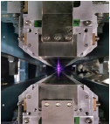
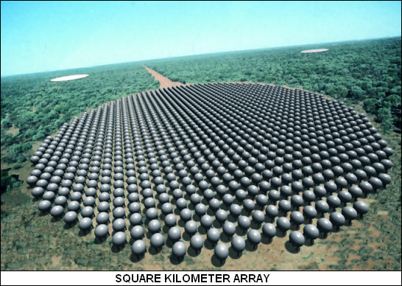
Data Explosion in High Performance Computing
Modern scientific discoveries are driven by data
By 2020, climate data is expected to be hundreds of exabytes or more
LHC experiments produce petabytes of data per year
Light source experiments at LCLS, ALS, SNS, etc. produce tens of TB/day
1 Exabyte per a day (10 petabytes every hour)
Storing, analyzing, and visualizing large data are big challenges
VPIC is a simulation that pushes the limits of data management tools on large supercomputers

Slide 3
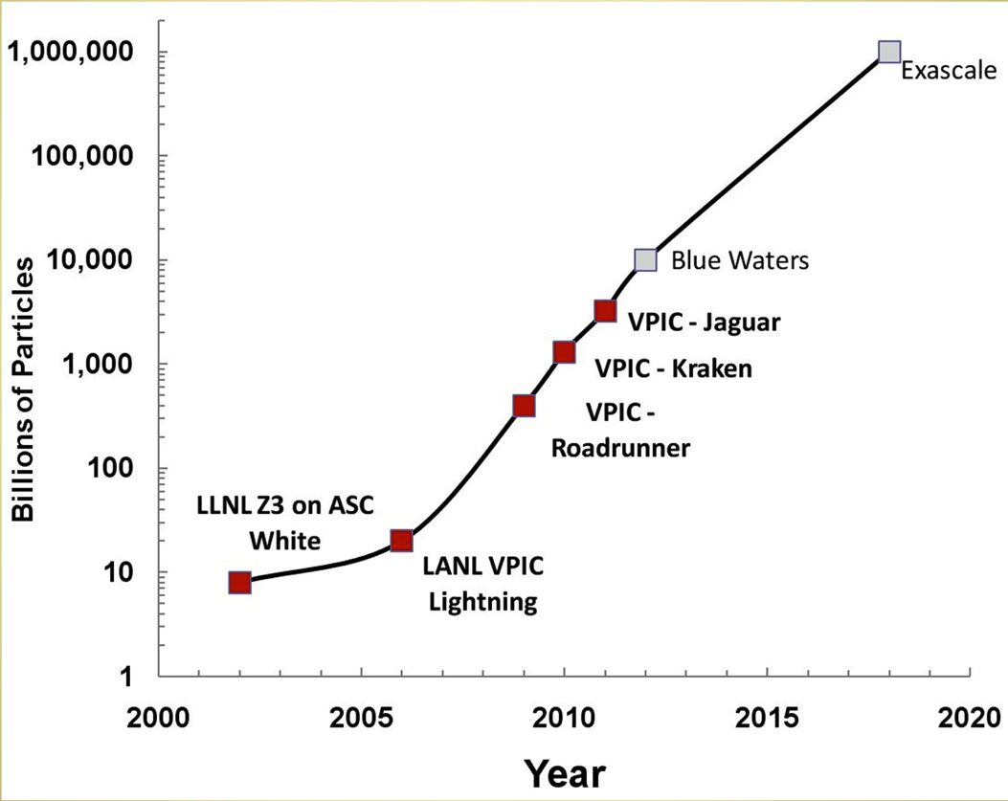
Vector Particle-in-Cell (VPIC) Simulation
A state-of-the-art 3D electromagnetic relativistic PIC plasma physics simulation
It is an exascale problem and scales well on large systems
An open boundary VPIC simulation of magnetic reconnection
NERSC Hopper Supercomputer
VPIC-Hopper
6,384 compute nodes; 2 twelve-core AMD 'MagnyCours' 2.1-GHz processors per node; 32 GB DDR3 1333-MHz memory per node; Interconnect with a 3D torus topology
Lustre parallel file system with 156 OSTs at a peak BW of 35 GB/s

Slide 4
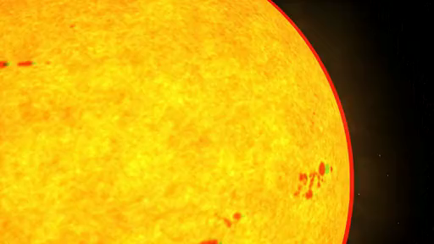
Trillion Particle Simulation
Simulates collisionless magnetic reconnection
Reconnection is an important mechanism that releases energy explosively as field lines break and reconnect in plasmas
Example: Earth’s magnetosphere’s reaction to solar eruptions
Trillion electrons and Trillion Ions
Uses 120,000 CPU cores
20,000 MPI processes and each process has 6 OpenMP threads
Writes electron data of 30 to 36 TB every ~2000 time steps
Total 10 such particle datasets [340 TB]
Electric and Magnetic field data is another 45 TB
Animation from NASA

Slide 5
Data Challenges
What is a scalable I/O strategy for storing massive particle data output?
In situ analysis works well when analysis tasks are known a priori
Many scientific applications require to store data for exploratory analysis
What is a scalable strategy for conducting analysis on these datasets?
Sift through large amounts of data looking for useful information
What is the visualization strategy for examining the datasets?
Display information that makes sense

Slide 6
Science Questions
Understanding physical mechanisms responsible for producing magnetic reconnection in a collisionless plasma is important to characterize the symmetry properties of the particle distribution
Agyrotropy: A quantitative measure of the deviation of the distribution from cylindrical symmetry about the magnetic field
Analysis of highly energetic particles
Are the highly energetic particles preferentially accelerated along the magnetic field?
What is the spatial distribution of highly energetic particles?
What are the properties of particles near the reconnection hot-spot (the so-called X-line)?
What is the degree of agyrotropy in the spatial vicinity of the X-line?

Slide 7
Our Tools and Techniques
Scalable I/O strategy for storing particle data
H5Part: A simple API on top of HDF5 to read/write particle data
Search for Lustre striping optimizations
Scalable strategy for conducting analysis on these datasets
FastBit: Bitmap index generation and querying software
Hybrid Parallel FastQuery
API to generate bitmap indexes
API to query indexed or data from different data formats (HDF5, NetCDF, and ADIOS-BP)
Visualization strategy for examining the datasets
Query-driven visualization using VisIt

Slide 8
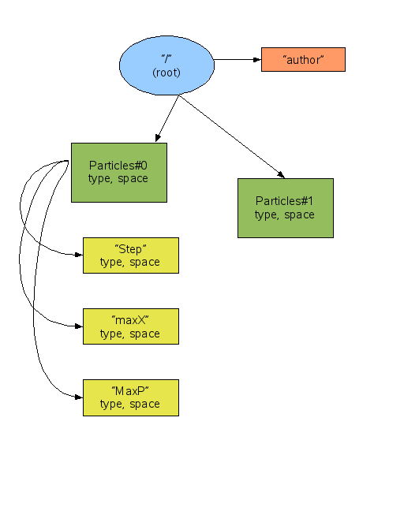
H5Part
A simple API on top of HDF5 to read/write data to the HDF5 file format
Portable high performance parallel data interface
Building blocks of H5Part
Particles
Block structured data (H5Block and H5MultiBlock)
One file for all data
Plugins available for visualization tools (VisIt and ParaView)

Slide 9
Data Analysis: Indexing and Querying
Most data analysis tasks are performed on a subset of a dataset instead of the whole dataset
Need a fast indexing for real-time analysis
To find data quickly, database technology has SQL
FastBit provides querying capability for fast scientific data access
Indexes and stores each column data separately
Generates compressed bitmap indexes
Search speeds are 10X-100X better than the best known bitmap indexing methods
Can search billion data values in a few seconds
Size: On average about 1/3 of data volume compared to 3-4 times in common indexes (e.g. B-trees)

Slide 10
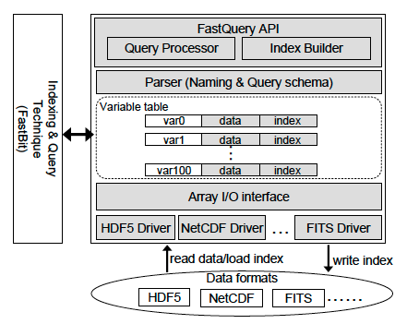
Hybrid Parallel FastQuery
FastQuery: An API to query arbitrary scientific data formats
Uses FastBit indexing and querying technology
Parallel implementation previously used MPI-only
Recent implementation uses hybrid parallelism to utilize multicore CPUs
MPI tasks spawn a fixed number of threads (used Pthreads)
Threads perform indexing and querying functions on fixed size sub-arrays of data assigned to them

Slide 11
Visualization Challenge
Visualizing too much data on computer displays is a challenge
Typical computer displays have O(1M) pixels and brute force rendering a trillion particles implies an overdraw factor of O(1M)
Traditional Visualization Pipeline
Data
Vis/Analysis
Display

Slide 12
Query-driven Visualization
Reduced the number of particles before rendering by down-selecting the scientifically interesting features
Highly energetic particles in this case
New feature: Cross-Mesh Field Evaluation (CMFE)
Correlate particle data with the underlying magnetic field data
FastBit & FastQuery
Query-driven Visualization Pipeline
Data + Index
Query
Vis/Analysis
Display

Slide 13
System Configuration
NERSC Hopper supercomputer
6,384 compute nodes
2 twelve-core AMD 'MagnyCours' 2.1-GHz processors per node
32 GB DDR3 1333-MHz memory per node
Employs the Gemini interconnect with a 3D torus topology
Lustre parallel file system with 156 OSTs at a peak BW of 35 GB/s
Software
Cray’s MPI library (xt-mpt 5.1.2)
HDF5 1.8.8 library with H5Part 1.6.6
FastQuery and FastBit
VisIt 2.4

Slide 14
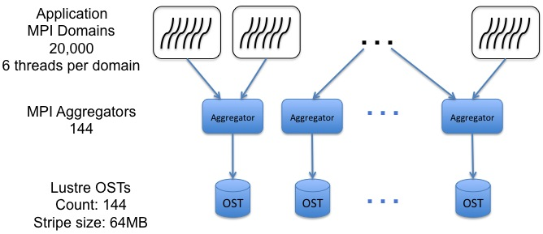
VPIC Trillion Particle Simulation setup
An open boundary VPIC simulation consisting of 2000 x 2000 x 800 computational cells
Each MPI domain processes ~51 Million (±15%) particles
Non-uniform number of particles
Lustre-aware MPI-IO implementation
MPI collective buffer size is equal to the stripe size
Number of MPI aggregators is equal to the stripe count
Particle data size varies (~30 to 36TB), written into 1 large HDF5 file
Each particle has 8 variables

Slide 15
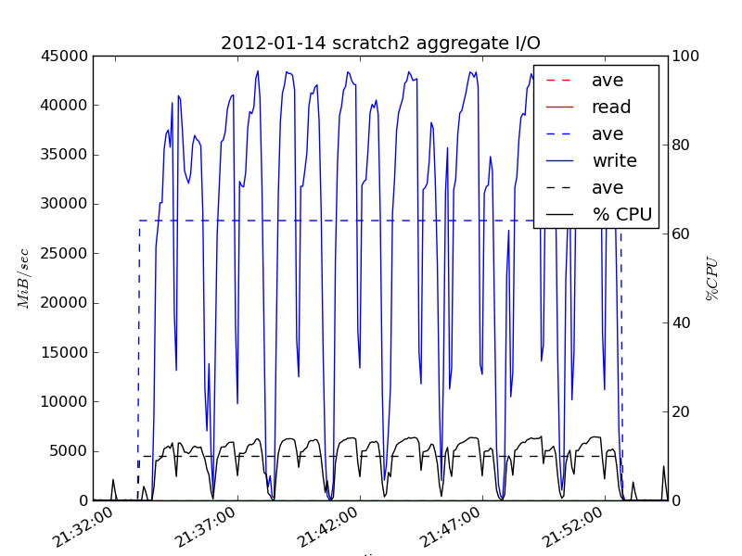
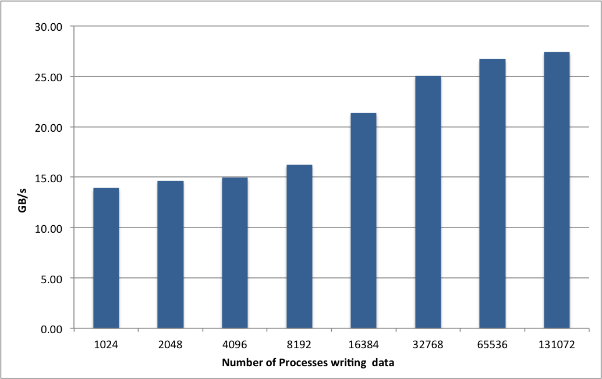
VPICBench: A Skeleton of VPIC Particle I/O
Scaling study with increasing data with increasing number of processes
Each process wrote 8M particles (uniform number for all MPI domains)
Varied stripe count from 64 to 156 and stripe size from 1MB to 1GB
Choice of 144 stripes and 64MB stripe size were optimum for these runs
At the 128K cores, VPICBench writes 32TB data with an I/O rate of 27 GB/s
Transient I/O rates using Lustre Monitoring Tool shows reaching peak I/O rates

Slide 16
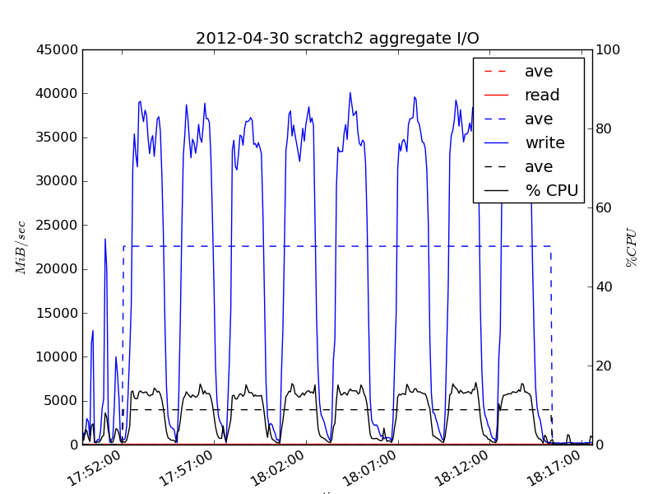
Performance of Writing Trillion Particles
Reached I/O peak rate in writing each variable
Amortized I/O rate of 24 GB/s
Found 12 OSTs running 30% slower causing a slight slowdown
Recent tests without faulty OSTs show 26 GB/s rate

Slide 17
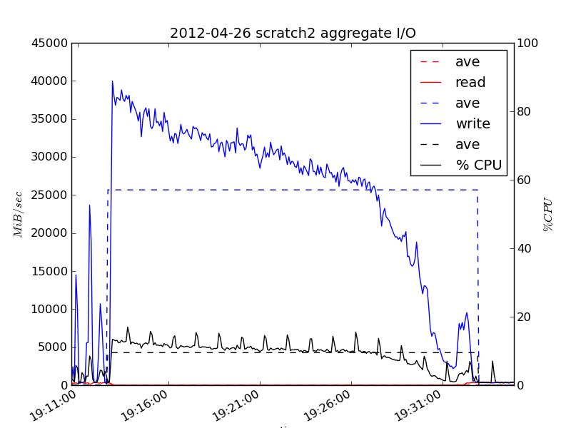
Writing Trillion Particles – File per Process
20,000 MPI domains write one file per process
Amortized I/O rate of 26 GB/s
Disadvantages of FPP
FPP model dictates the concurrency of subsequent stages in the analysis pipeline
Data management and visualization tools only support standard formats such as HDF5

Slide 18
Performance of Indexing with Hybrid FastQuery
Overall advantage of hybrid parallel implementation over MPI-Only implementation
Building index step scales linearly, but I/O doesn’t scale

Slide 19
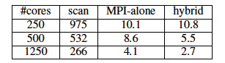
Performance of Querying with Hybrid FastQuery
Queried for particles where ‘Energy > 1.3’ from the trillion dataset
Takes about 2.7 seconds to sift through 3.8TB data
Better than MPI-only

Slide 20
Science question Are the highly energetic particles preferentially accelerated along the magnetic field?
Data at time step 1905
Showing all the particles with ‘Energy > 1.3’ in gray and those with ‘Energy > 1.5’ in color
164,856,597 particles with Energy > 1.3 and 423,998 particles with Energy > 1.5

Slide 21
Science question Are the highly energetic particles preferentially accelerated along the magnetic field?
Data at time step 1905
Showing the density of all particles with ‘Energy > 1.3’ in the U_{x} – U_{y} plane
Show preferential acceleration of the plasma in the direction parallel to the average magnetic field as evidenced by the highly distorted distribution function in the x-y plane

Slide 22
Science question Are the highly energetic particles preferentially accelerated along the magnetic field?
Scatter plot showing all particles with ‘Energy > 1.5’ in U_{y} and U|| space colored by Energy
Strong correlation between U_{y} and U||
The particles of high energy appear in regions of high negative U||
The high energy particles are aligned (i.e., move parallel) to the magnetic field.

Slide 23
Science question What is the spatial distribution of highly energetic particles?
Plot showing all particles with ‘Energy > 1.5.’
The query selects ~0.05% of all particles
Different particle structures with strong positive (red) and negative (blue) U|| values

Slide 24
Science question What are the properties of particles near the reconnection hot-spot?
The X-line, where magnetic reconnection happens
Particle distribution of Uperp1 vs. Uperp2 in the vicinity of X-line
The lack of cylindrical symmetry about the local magnetic field, called Agyrotropy
This confirms the expected signature of the reconnection site in collisionless plasma

Slide 25
Conclusions
Addressed the data management and analysis challenges posed by a highly scalable plasma physics simulation
Storage: 26 GB/s
Indexing: 9 minutes to index 30TB data file
Querying: ~3 seconds
Demonstrated that exploratory analysis can handle challenges posed by large data
Using query-driven visualization approach, application scientists explored and gained insights from massive particle datasets for the first time
Several of the phenomena visualized in this study have been conjectured about, but the capabilities developed here can unlock the scientific insights in unprecedented data

Slide 26




Thanks!

Slide 27


